Slide 1


INFO-648-900 Group Project Spring 2022
Team Purple
Kunal Chhabria (kc3575)
Mangesh Raut (mbr63)
Stefanie Jackson (sj972)
Professor Prudence Dalrymple
Artificial Intelligence In Medicine
Journal homepage:
https://www.sciencedirect.com/journal/artificial-intelligence-in-medicine

Slide 2
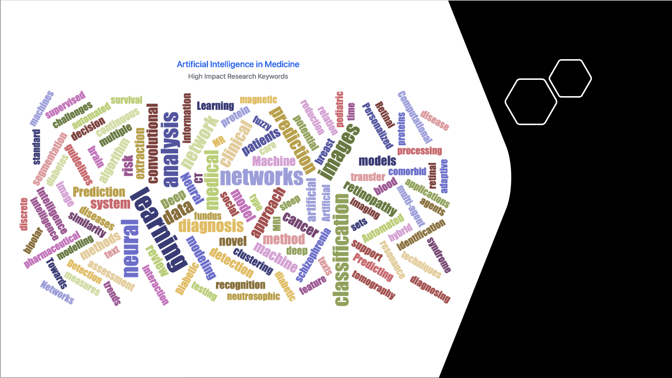

Slide 3
Introduction
In computer science, artificial intelligence (AI), sometimes called machine intelligence, is intelligence demonstrated by machines, in contrast to the natural intelligence displayed by humans and animals.
The term "artificial intelligence" is used to describe machines that mimic "cognitive" functions that humans associate with other human minds, such as "learning" and "problem solving".
An algorithm is a set of unambiguous instructions that a mechanical computer can execute. Many AI algorithms are capable of learning from data and can themselves write other algorithms.
Machine learning is an application/subfield of artificial intelligence (AI) that provides systems the ability to automatically learn and improve from experience without being explicitly programmed.

Slide 4
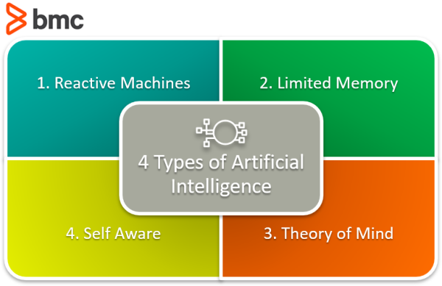
Overview of Artificial Intelligence
Reference: https://www.bmc.com/blogs/artificial-intelligence-types/
Notes:
Reference: https://www.bmc.com/blogs/artificial-intelligence-types/

Slide 5
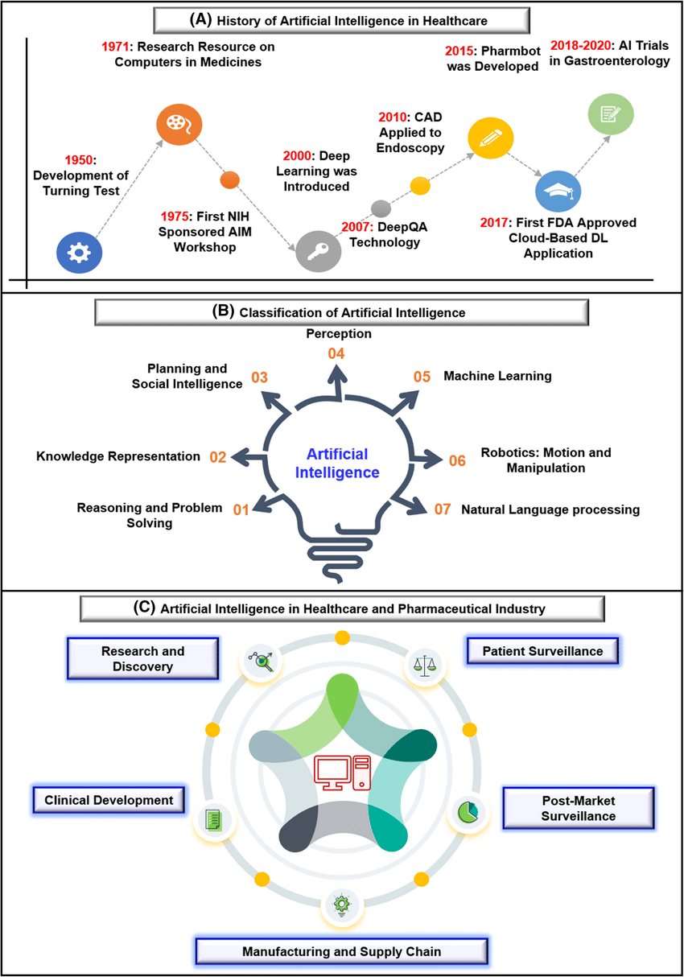

Slide 6
Neural network modelling of soft tissue deformation for surgical simulation • A new neural network methodology for modeling of soft tissue deformation for real-time, realistic, and stable surgical simulation. • Two CNN models have been developed to carry out soft tissue deformation via (i) neural propagation and (ii) dynamics by combining bioelectric energy propagation of soft tissues with mechanical deformation dynamics. • The proposed methodology not only satisfies the real-time requirements of surgical simulation but also achieves the physical behaviors of soft tissue deformation. Further, it also achieves stable model dynamics for soft tissue simulation, but with similar computational efficiency to the explicit time integration. • Simulation and experimental results demonstrate that the proposed method exhibits nonlinear force-displacement relationships and the associated nonlinear deformation behaviors of soft tissues. Further, the proposed method can accommodate not only homogeneous but also anisotropic and heterogeneous materials by simple modification of the electrical conductivity values of mass points.

Slide 7
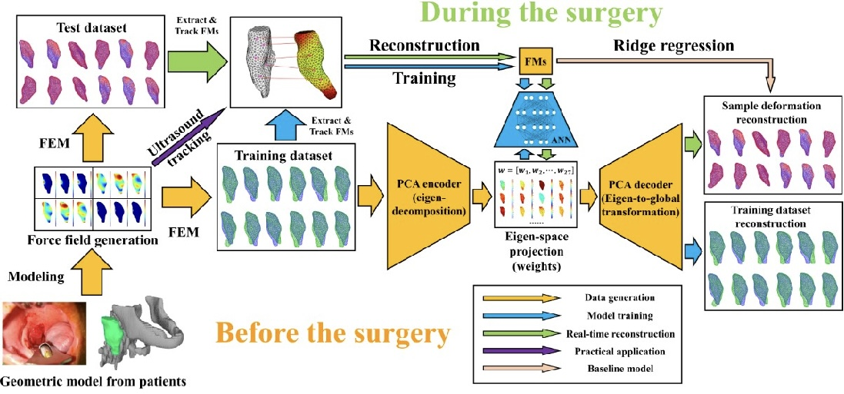
Figure: Flowchart of using proposed scheme for predicting tissue deformation during procedure.

Slide 8
Deep learning based computer-aided diagnosis systems for diabetic retinopathy: A survey • This review provides a comprehensive overview of cutting-edge deep learning-based methods for diabetic retinopathy diagnosis and will assist researchers in conducting additional research on this topic. • The survey gives an overview of different diabetic retinopathy biomarkers and lesions and different tasks related to diagnosis. Also, we have given an overview of datasets, which have been developed for research on diagnosis and commonly used performance metrics. • Various bibliographic reference sources are used to explore the diverse applications of deep learning algorithms in the diagnosis of diabetic retinopathy, most of which have appeared recently. • It covers deep learning-based methods, which have been proposed for retinal blood vessel segmentation, OD detection and segmentation, and the detection of various lesions such as EXs, MAs, HMs, and referable diabetic retinopathy. • The review mentioned deep learning-based methods in diabetic retinopathy and discussed their overall performance, gaps, and future directions. Also, it gives a comparison with state-of-the-art traditional methods based on hand-engineered features.

Slide 9
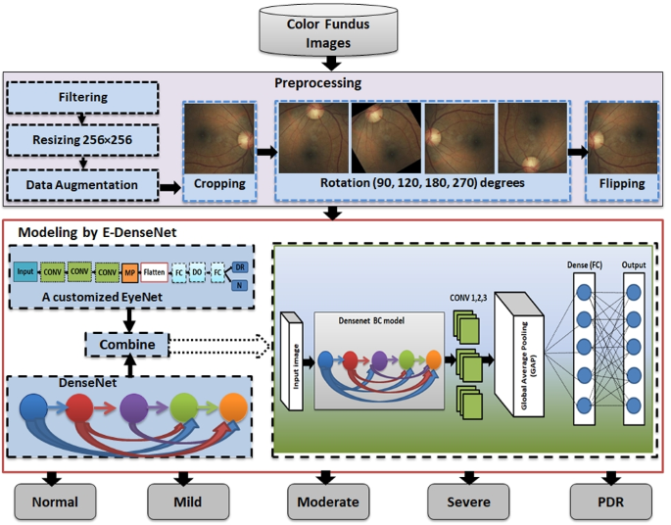
Fig. The proposed CAD system

Slide 10

A hybrid machine learning approach to cerebral stroke prediction based on imbalanced medical dataset • A hybrid machine learning approach is used to predict strokes via an incomplete and imbalanced medical dataset. • Instance selection of automated hyperparameter optimization (AutoHPO) successfully extracts hard-classified samples to reduce the imbalance ratio. • An online-learning strategy is used to reweight each batch of the training set and optimize the parameters of the model based on validation loss rather than training loss as usual, which achieves impressive performance on imbalanced datasets.

Slide 11
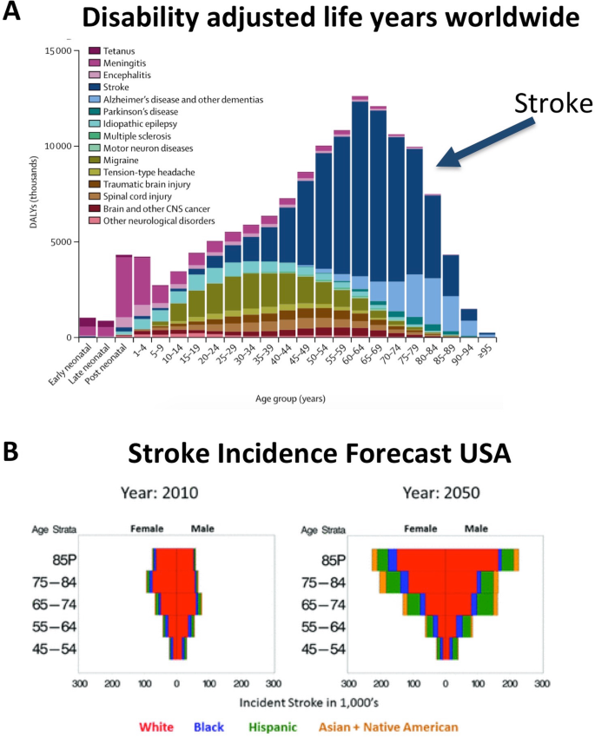

Slide 12
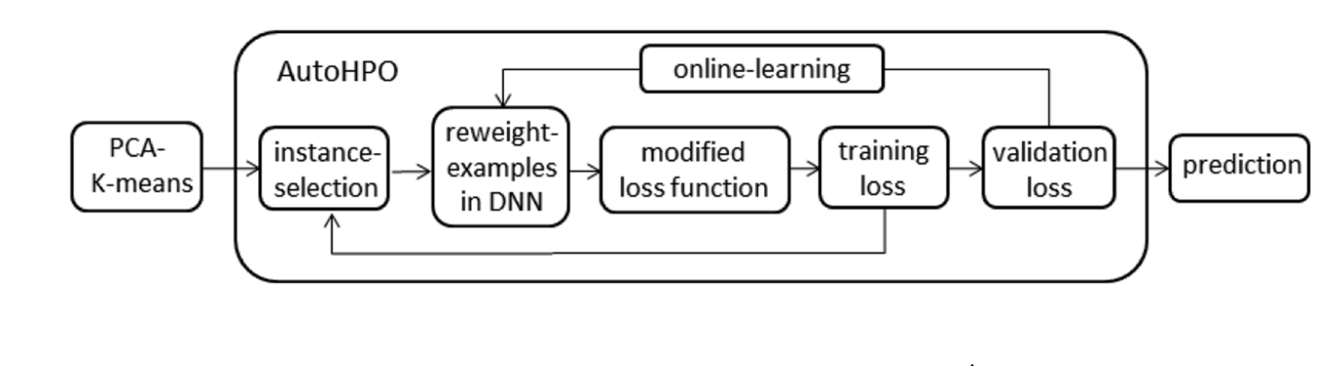
Auto Hyper Parameter Tuning before ML applying models

Slide 13
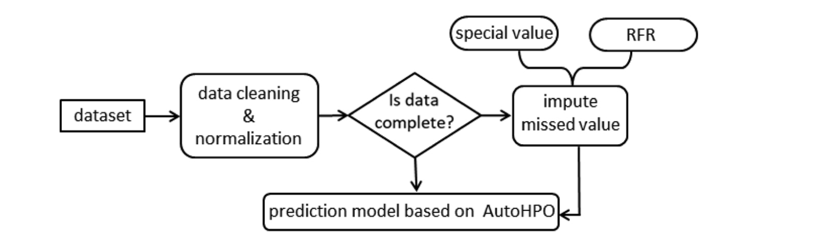
Overall procedure chart.

Slide 14
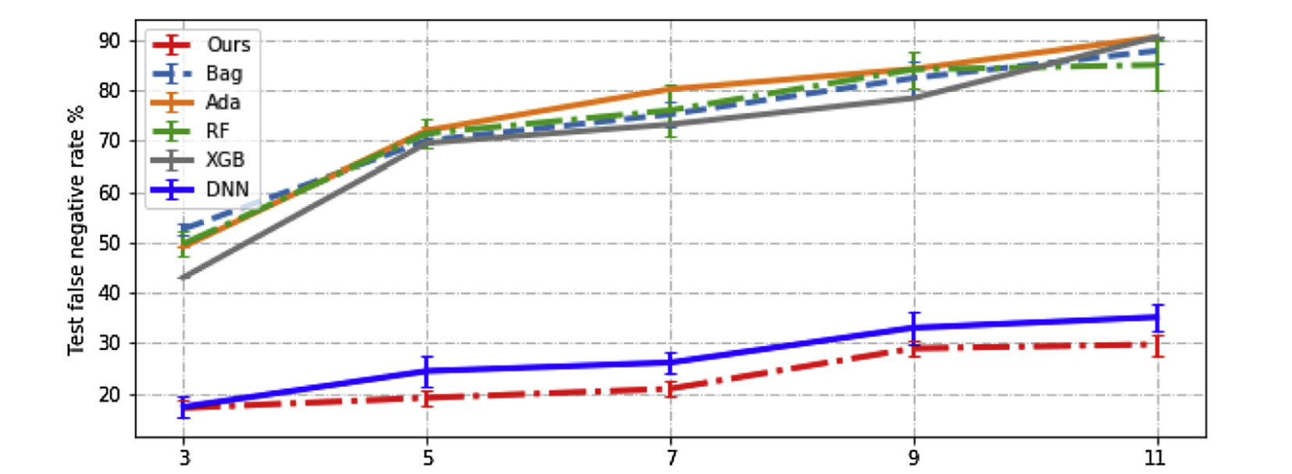
Results of regular ML models compared to the study model

Slide 15

Conclusion
Artificial intelligence is changing the world we live in.
Artificial intelligence is used in healthcare, finance, insurance, and other fields.
The use of artificial intelligence is a controversial topic and will be securitized for every mistake.
A lot of people do not understand the outcomes of more advanced AI systems.
The lack of understanding of more advanced AI will slow its integration into healthcare systems and EHR systems.

Slide 16

Thank You.

